Slide 1
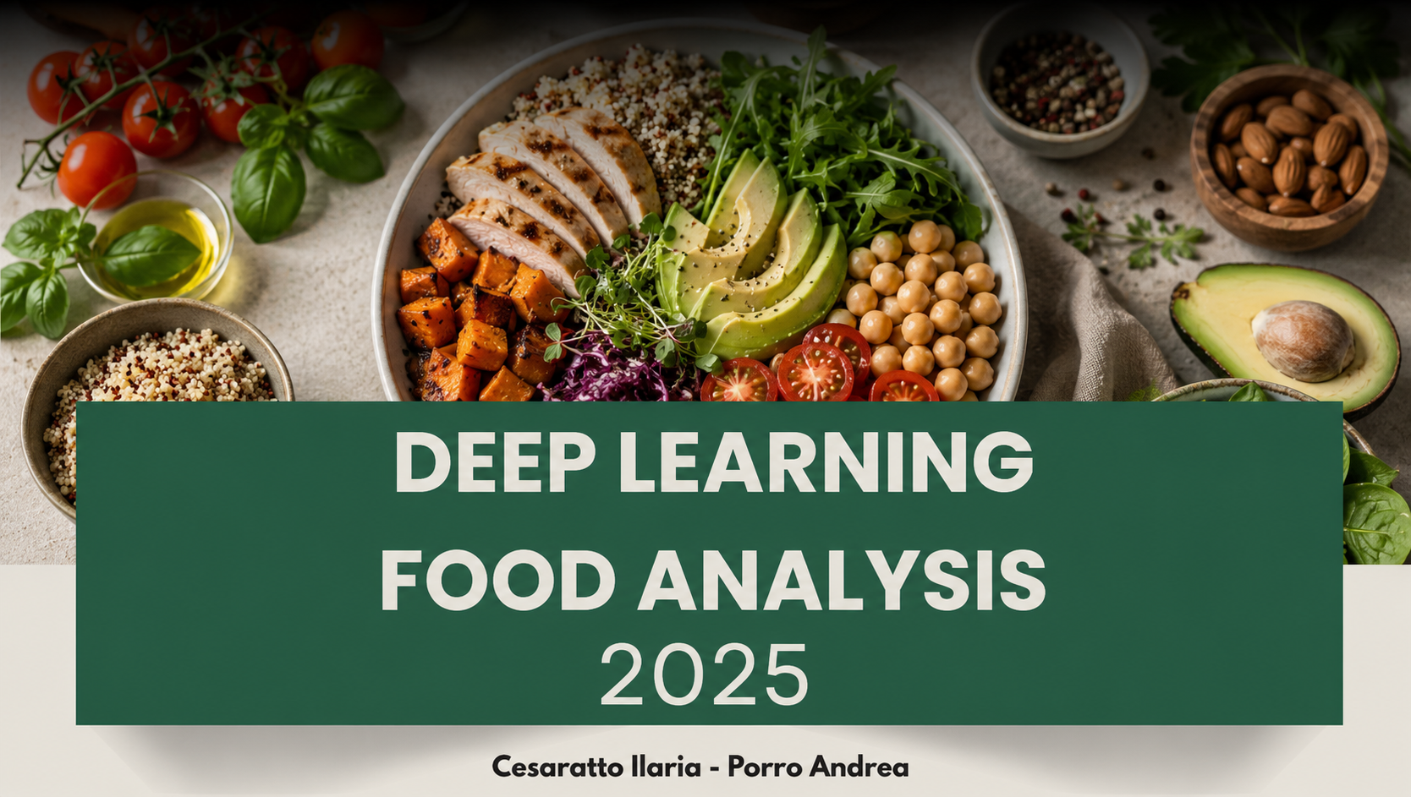
DEEP LEARNING
FOOD ANALYSIS

Slide 2
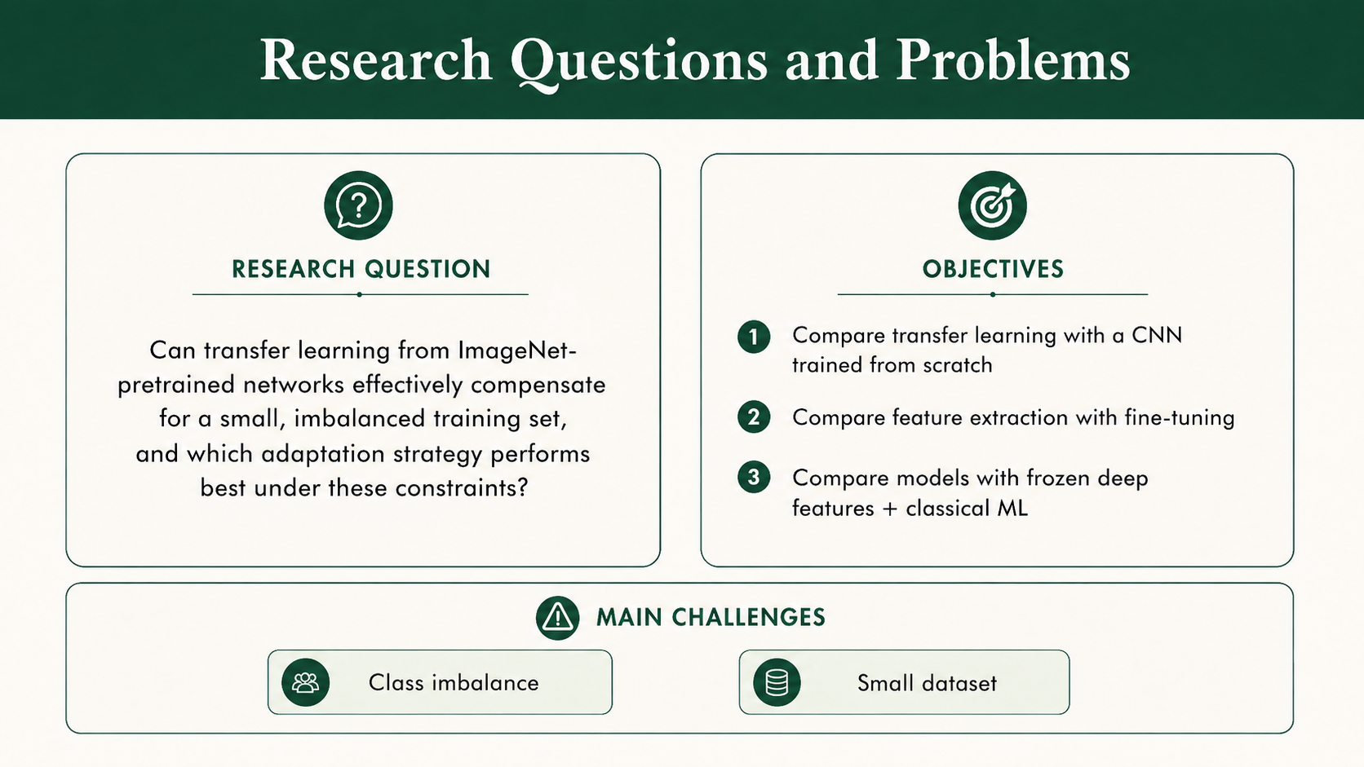
Research Questions and Problems

Slide 3
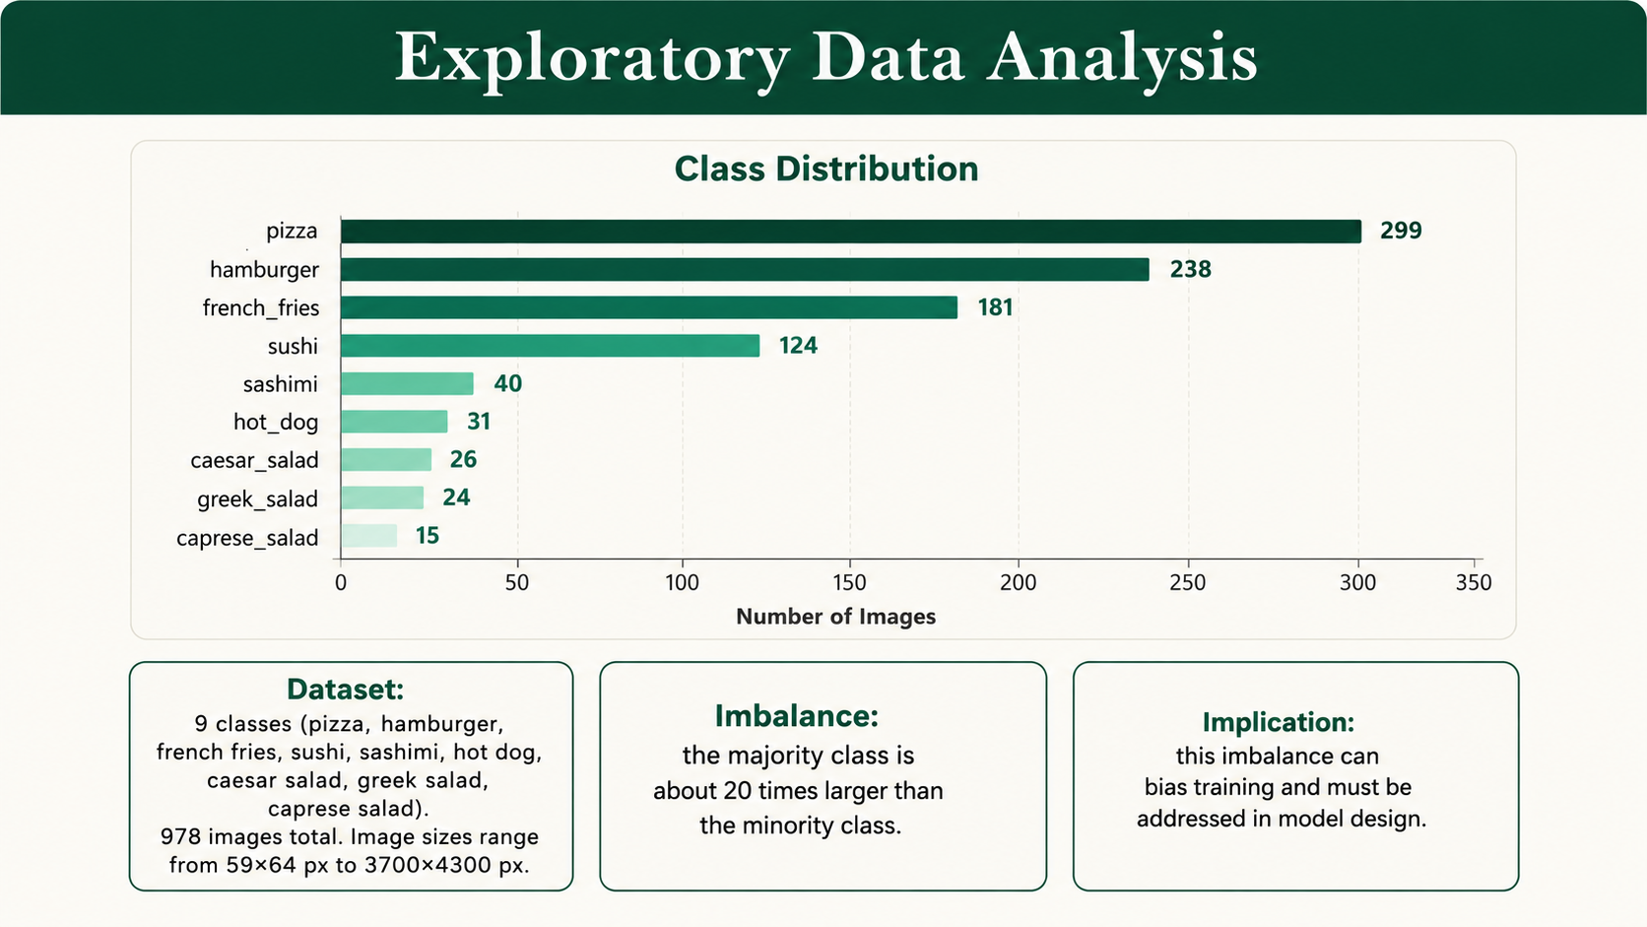
Exploratory Data Analysis

Slide 4
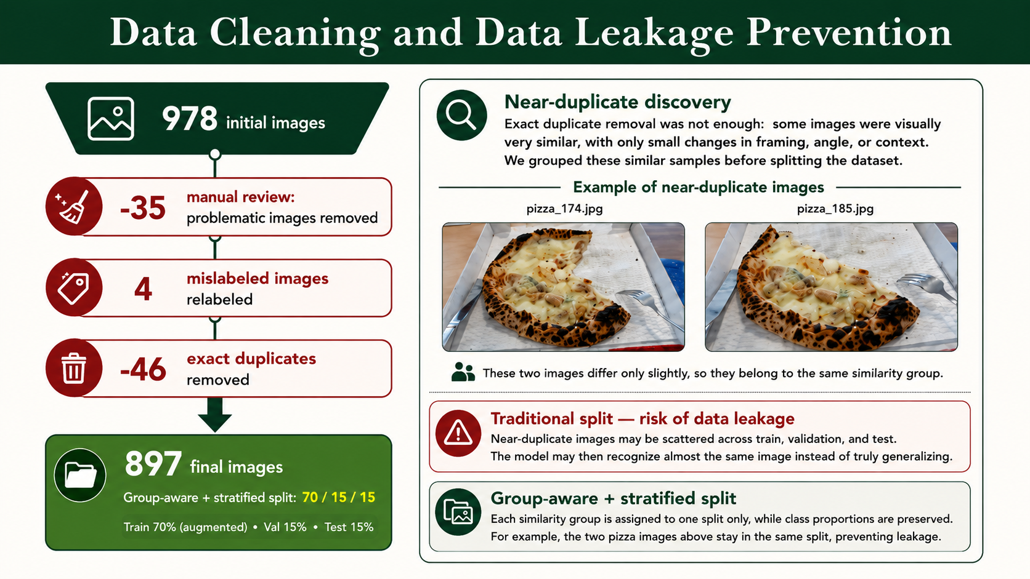
Data Cleaning and Data Leakage Prevention

Slide 5
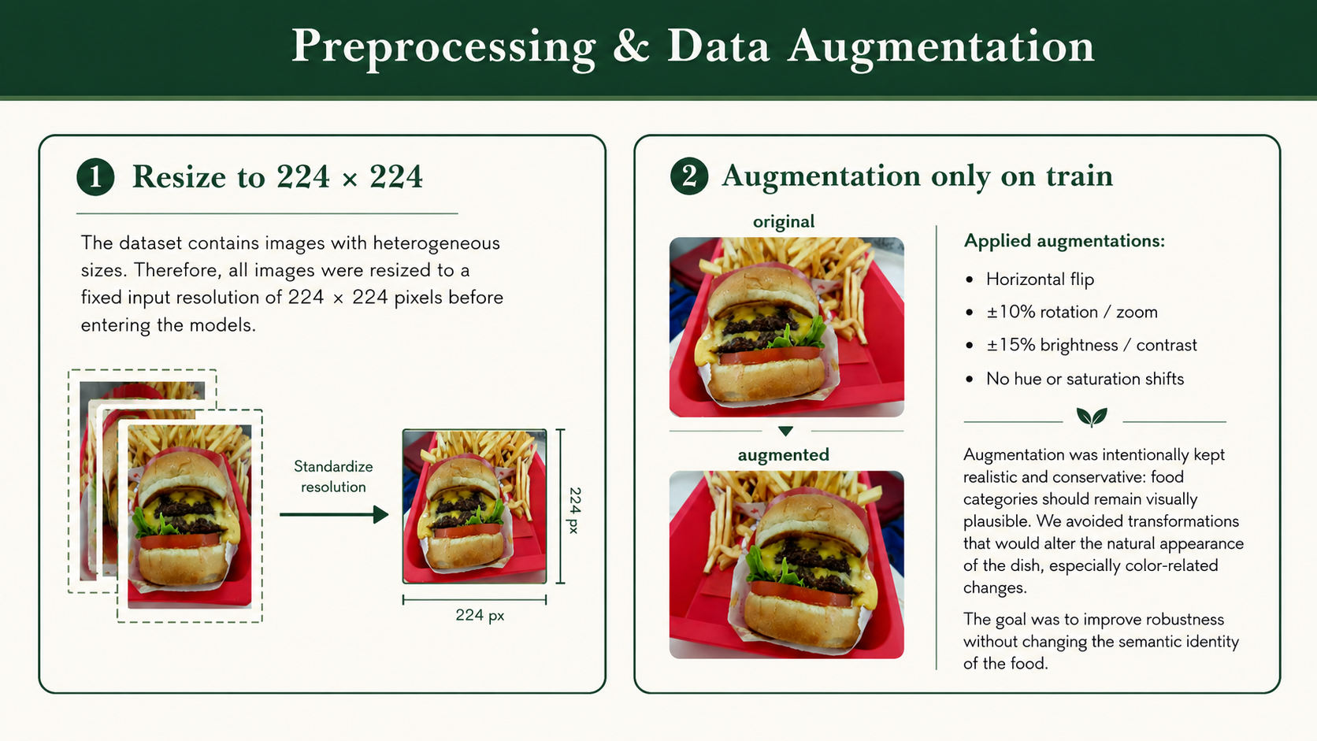
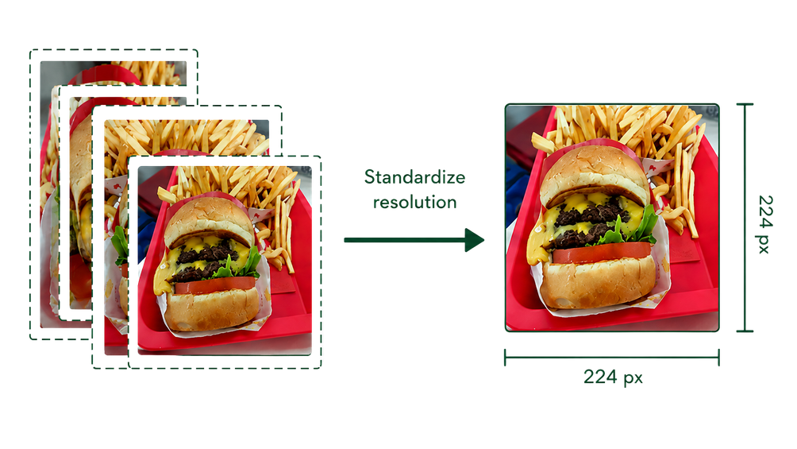
Preprocessing & Data Agumentation

Slide 6
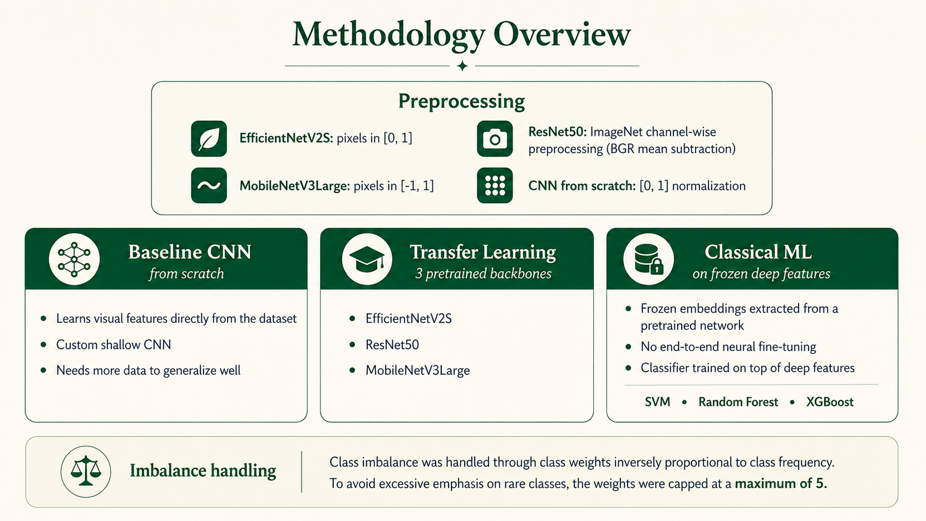
3 Modeling Strategies

Slide 7
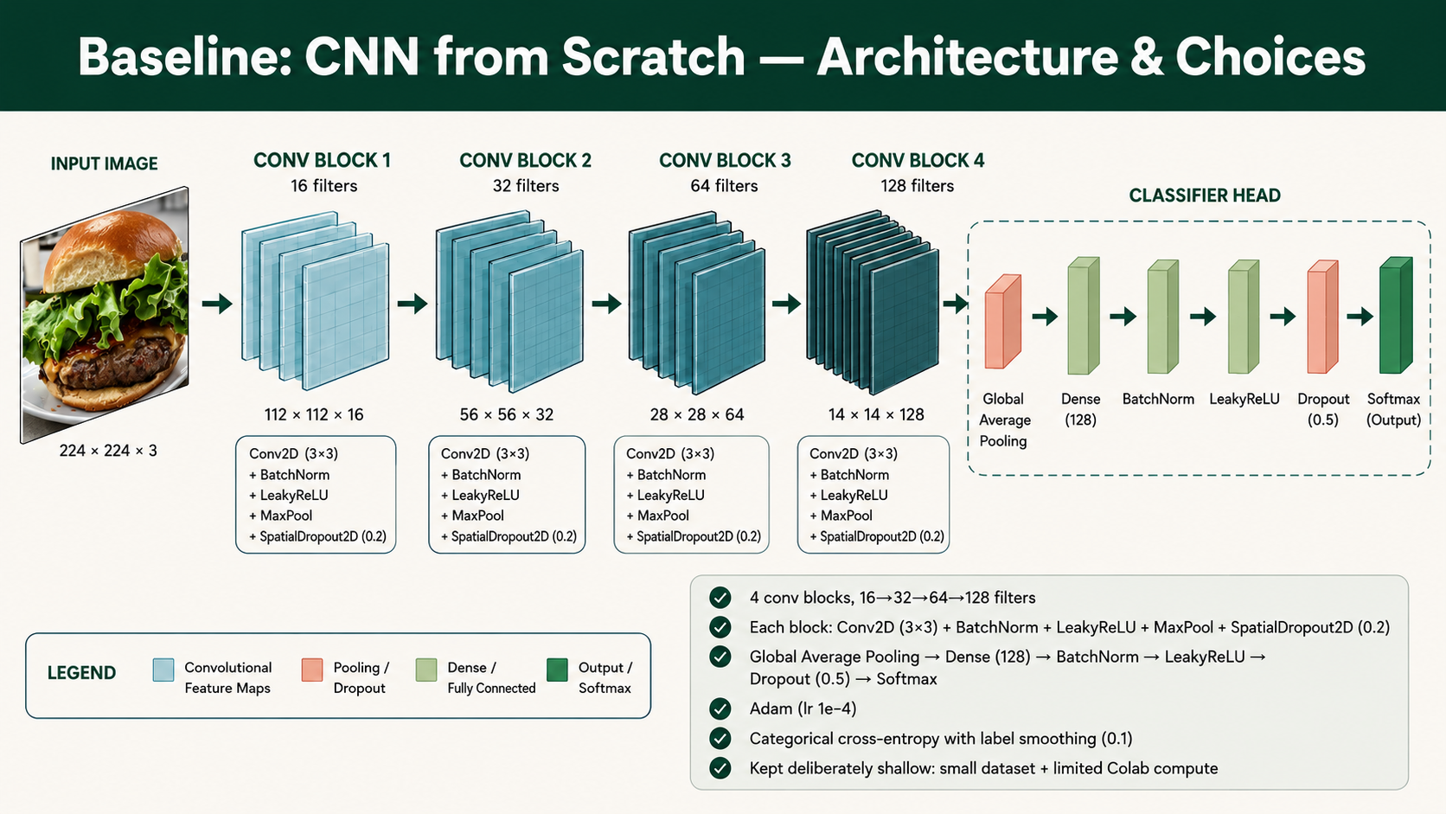
Baseline: CNN from Scratch

Slide 8
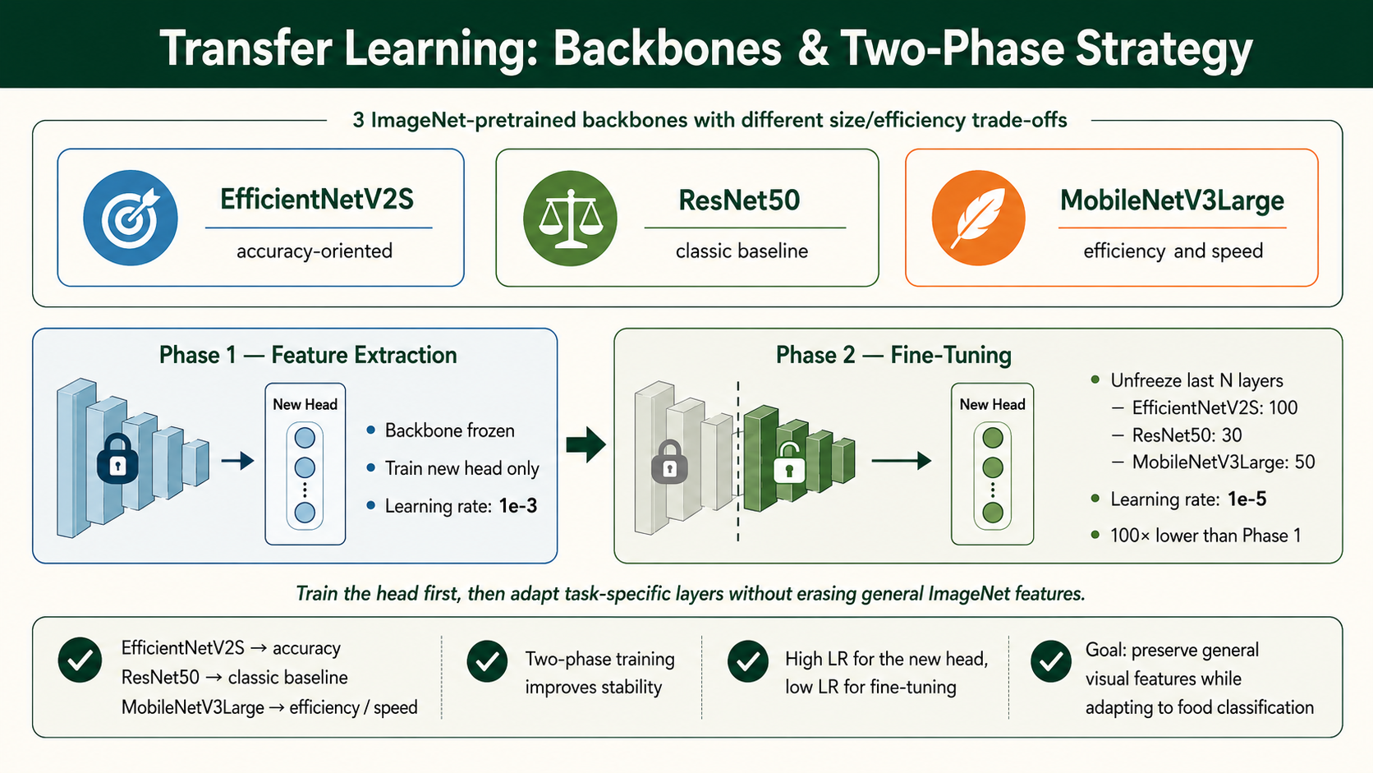
Transfer Learning:
Backbones & Two-Phase Strategy
3 ImageNet-pretrained backnones were used
EfficientNetV2S
ResNet50
MobileNetV3Large
Accuracy
Classic Baseline
Speed

Slide 9
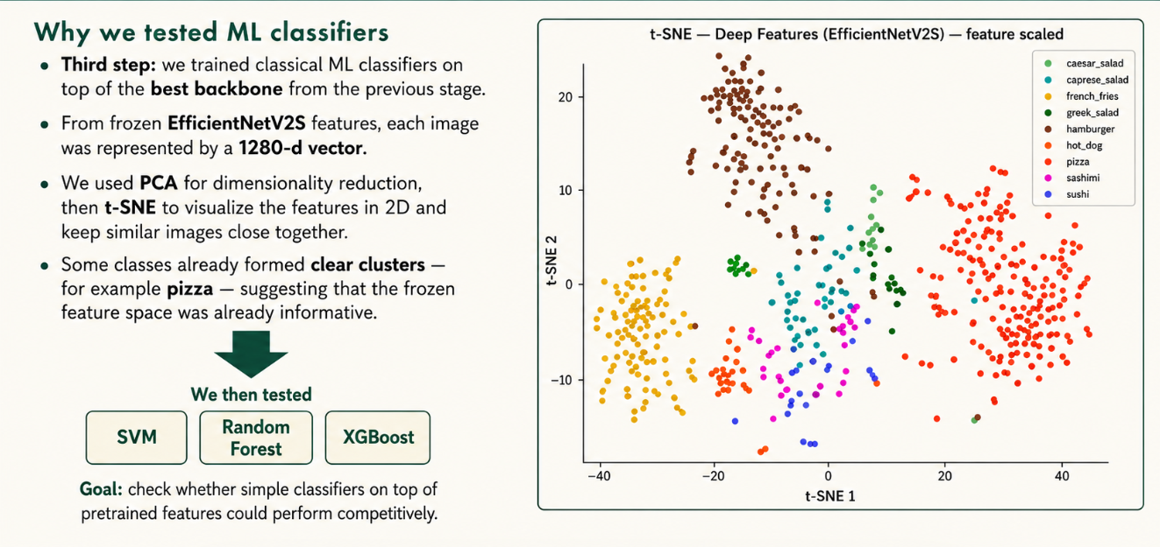
From Frozen Features to Classical ML

Slide 10
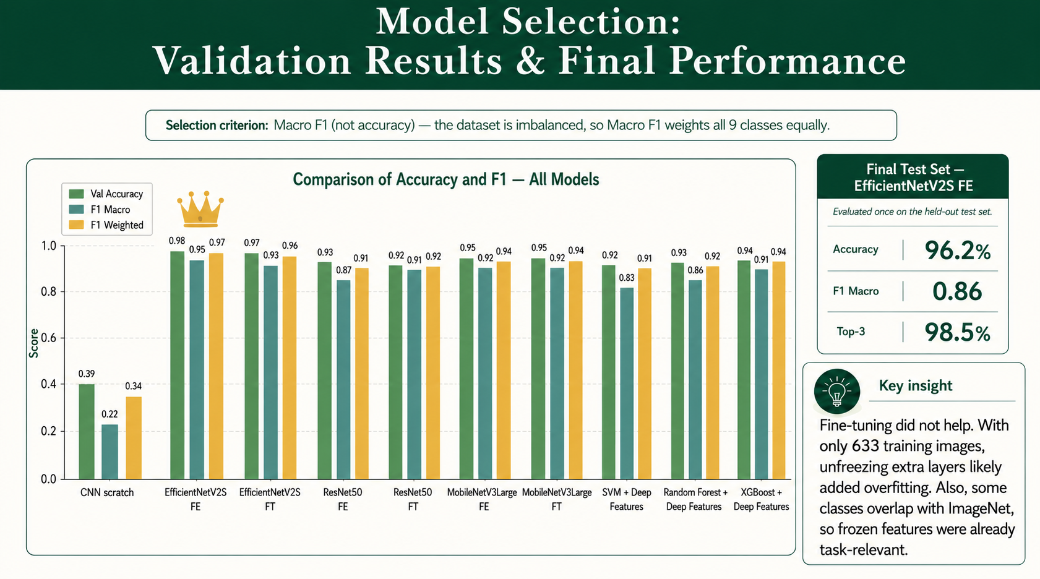
Model Selection:
Validation Results & Final Performance

Slide 11
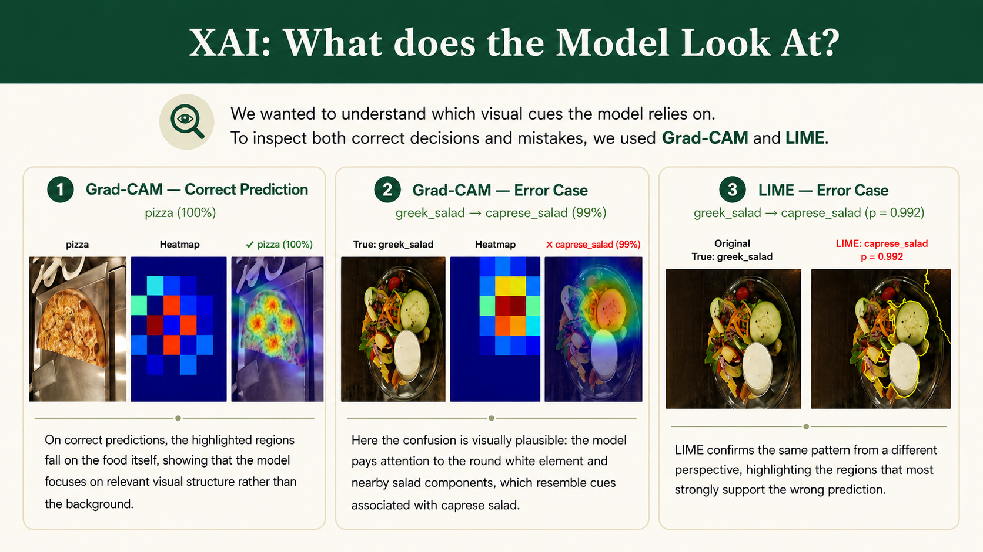

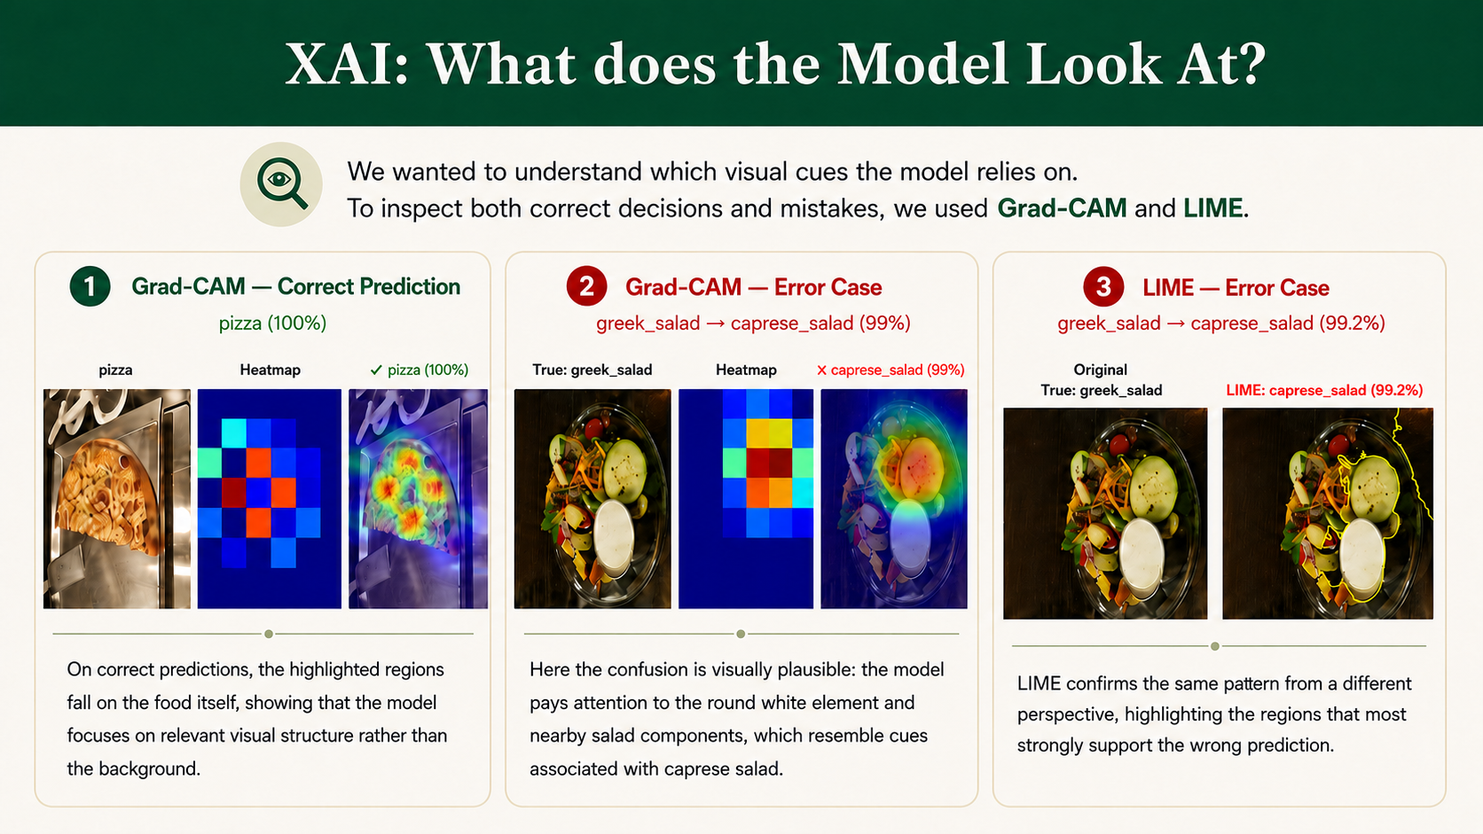
XAI: What does the Model Look At?

Slide 12
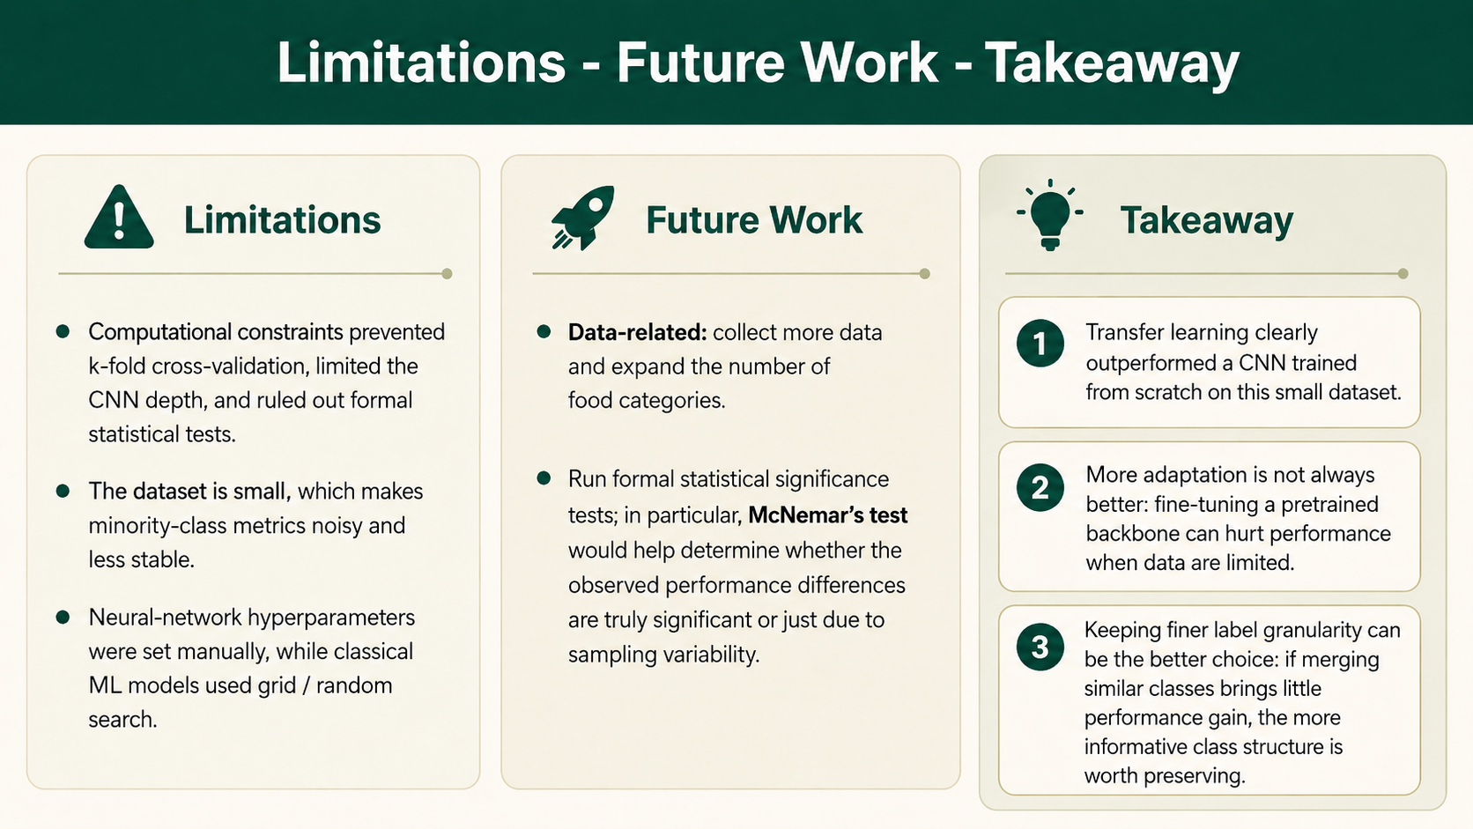
Limitations - Future Works - Takeaway

Slide 13
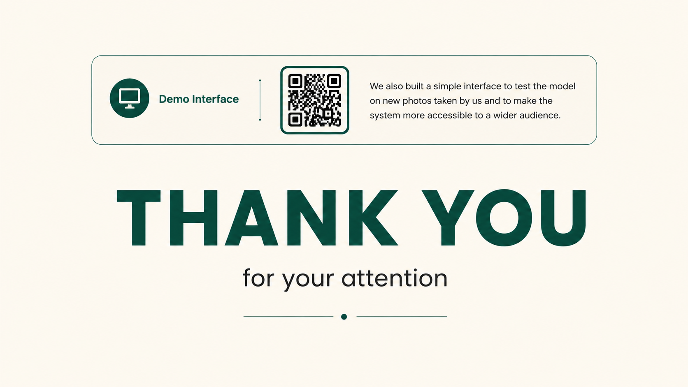

linkhttps://huggingface.co/spaces/IlariaCesa/food_FDL

Slide 14
Appendix - Curiosity
"Why did fine-tuning perform worse, or the same, as feature extraction?"
Because our training set is very small — only 633 images. When we unfreeze many layers, we add a lot of trainable parameters, and the model starts fitting the noise in the training data instead of learning real patterns. This is overfitting.
There is also a second reason: some of our classes — like pizza, hot dog, and hamburger — already exist in ImageNet, so the frozen backbone already had very good features for our task. Fine-tuning had little room to improve, and it introduced noise instead.
"Why didn't we use cross-validation?"
Cross-validation would require retraining each model multiple times. In our case, we have 3 backbones × 2 phases plus a CNN, each taking many minutes on Colab's free GPU. Doing 5-fold cross-validation would have multiplied the training time by 5, which was not feasible. Instead, we carefully built our split — stratified and group-aware — to make sure it was as representative as possible of the full dataset.

Slide 15
Appendix - Curiosity
"Why is the macro F1 lower on the test set (0.86) than on the validation set (0.93)?"
Mainly because some classes have very few test examples. Greek salad has only 3 images in the test set. If the model gets one wrong, the recall for that class drops dramatically, which pulls the macro F1 down. This is not necessarily a sign of overfitting — it is a consequence of having too few examples per class to get a stable estimate of performance.
"Why didn't we add warm-up to the fine-tuning phase?"
Warm-up gradually increases the learning rate at the beginning of training, to avoid large gradient updates before the optimizer has stabilized. We didn't use it because our fine-tuning learning rate was already very conservative — 1e-5, one hundred times smaller than the feature extraction phase. We also had EarlyStopping and ReduceLROnPlateau as safety mechanisms. On a small dataset, the impact of the first few batches is limited anyway.

